Slide 1
Design and Analysis of Algorithms
Recursive Algorithms
Week 9 and 10
By
Dr Rafiullah Khan
Senior Lecturer ICS/IT
The University of Agriculture Peshawar, Pakistan
For resources, please visit: https://rafiyz.github.io/courses/Algorithms/algo.htm

Slide 2
Recursion
A recursive procedure can often be analyzed by solving a recursive equation
Basic form:
  T(n) = if (base case) then some constant
  else ( time to solve subproblems +
  time to combine solutions )
Result depends upon
  how many subproblems
  how much smaller are subproblems
  how costly to combine solutions (coefficients)
Notes:
You may want to take notes on this slide as it just vaguely resembles a homework problem!
Here’s a function defined in terms of itself. You see this a lot with recursion. This one is a lot like the profile for factorial.
WORK THROUGH
Answer: O(n)

Slide 3
Recursive Factorial Function
Compute the factorial function F(n) = n! for an arbitrary nonnegative integer n. Since
  n! = 1 . . . . . (n − 1) . n = (n − 1)! . n for n ≥ 1
  and 0! = 1 by definition,
  we can compute F(n) = F(n − 1) . n with the following recursive algorithm.
ALGORITHM Fact(n)
{
if n = 0
return 1
else
return Fact(n − 1) ∗ n
}

Slide 4
Fibonacci Recursive Function
Fib(N)
{ if (N <= 1)
return 1;
else
return Fib(N-1) + Fib(N-2)
}

Slide 5
Exponent (Power) Function
int power(int base, int a)
{
if (a != 0)
return (base * power(base, a - 1));
else return 1;
}

Slide 6



Factorial Function – Running Time

Slide 7

The following algorithm finds the number of binary digits in the binary representation of a positive decimal integer.
ALGORITHM BinRec(n)
//Input: A positive decimal integer n
//Output: The number of binary digits in n’s binary representation
if n = 1 return 1
else return BinRec(n/2) + 1
Let us set up a recurrence and an initial condition for the number of additions A(n) made by the algorithm.
The number of additions made in computing BinRec(n/2) is A(n/2), plus one more addition is made by the algorithm to increase the returned value by 1. This leads to the recurrence

Slide 8
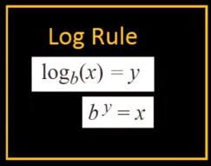

Logarithm Rule
How to calculate it:
$\frac{ln⁡(number)}{ln⁡(2)}$

Slide 9

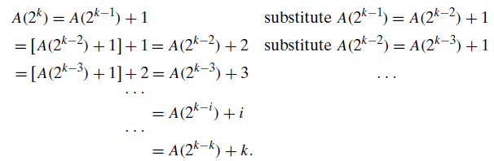


Now backward substitutions
Thus, we end up with
or, after returning to the original variable n = 2k and hence k = log₂ n,

Slide 10
Assignment
Book: Design and Analysis of Algorithm by Anany Levitin
Exercise 2.4 (page 76)
  Problems 1,2,3,4,8,9,10,13,14
Exercise 2.5
  Problems 1,2,3
Due on or before our next class

